Slide 1
SARCASM DETECTION ON REDDIT
Team Members:
Saishree Godbole & Tanvi Kolhatkar

Slide 2
PRESENTATION OUTLINE
Problem Statement
Project Workflow
Exploratory Data Analysis
Feature Engineering and Selection
Modelling Pipelines and Results
Conclusion
Next steps

Slide 3
PROBLEM STATEMENT
Why is detecting sarcasm important in social data science?
Understanding the context and tone (i.e., whether a statement is sarcastic or sincere) of comments left on social media and/or e-commerce websites can help us understand user behavior and market needs which in turn helps us create better business models and recommend product/services more efficiently.
For this, we are using a balanced dataset on Kaggle, (Sarcasm on Reddit) containing ~1.3 million labelled comments . The dataset was generated by scraping comments from Reddit containing the \s (sarcasm) tag.
Our goal is to build an efficient classification model that can detect sarcasm in comments on the Internet commentary website Reddit
We also aim to analyze the dataset to answer relevant questions like which Reddit topic has the highest percentage of sarcastic comments, whether the linguistic features(capital letters etc.) have any bearing on the sarcasm score

Slide 4
PROJECT WORKFLOW
Define the problem and finalize dataset
Perform EDA
Feature engineering and selection
Preprocessing of data
TFIDFvectorizer on ‘comments’ data
OneHotEncoder on categorical data
Scaling the numerical data
Train, split and evaluate all the models to determine best model
Build and deploy models:
Naïve bayes
Adaboost
GradientBoost
Build baseline Logistic Regression model

Slide 5
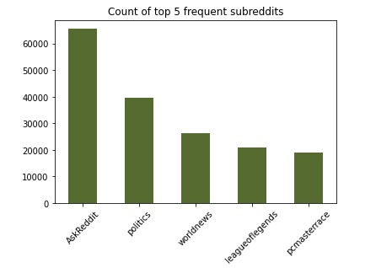
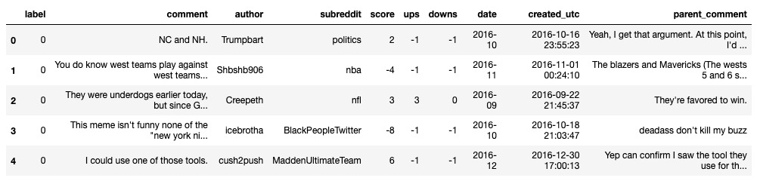
EXPLARATORY DATA ANALYSIS
The dataset is balanced with almost equal number of sarcastic and sincere comments

Slide 6
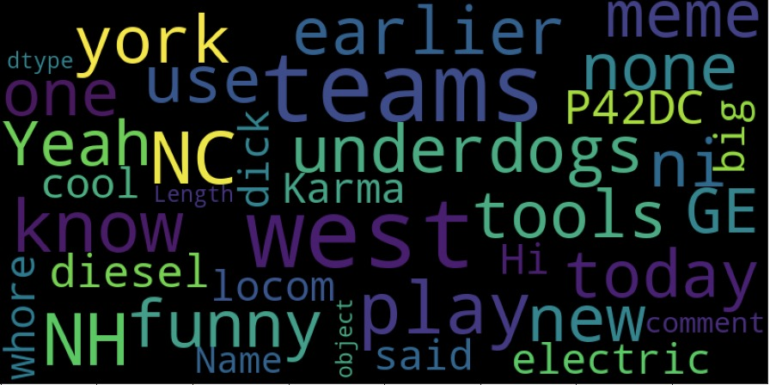
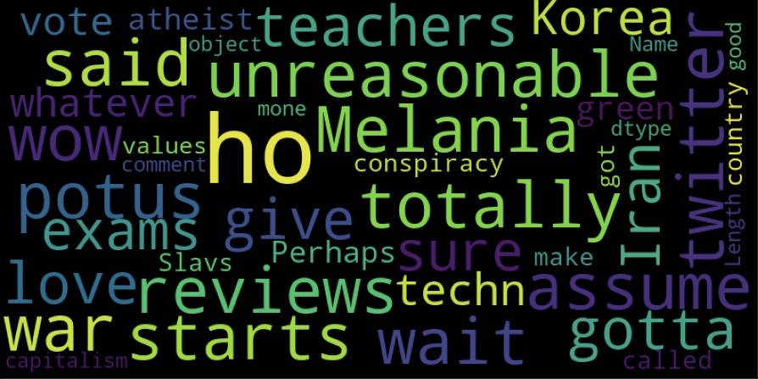
EXPLARATORY DATA ANALYSIS
WordCloud of the most frequent words in ‘sincere’ comments
WordCloud of the most frequent words in ‘sarcastic’ comments

Slide 7
FEATURE ENGINEERING AND SELECTION
Data Cleaning :
Based on the results of the EDA, we performed some basic data cleaning techniques like dropping rows with missing comments
Feature creation :
We converted the feature ‘created_utc’ to a datetime object and extracted ‘year’, ‘month’, ‘day’, ‘hour’, ‘minute’, ‘seconds’ attributes as separate features from it
We created features with count of capital letters to check the correlation of sarcasm with capital letter usage
Feature Selection :
Of all the existing and newly created features, we have retained only six features : three numerical, two categorical and one text feature by using the Pearson’s correlation method

Slide 8
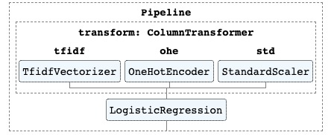
MODELLING PIPELINES & RESULTS
We built a baseline Logistic Regression model with the following steps:
Data preprocessing:
Tokenizing and learning vocabulary of the comments column using the TfidfVectorier
Converting the categorical feature values to binary using the OneHotEncoder
Scaling the numerical features using StandardScalar
Split dataset into train and test
Training: 80% and Testing: 20%
Train and evaluate the model
Evaluating the model using accuracy_score metric
Accuracy : 72.8%

Slide 9
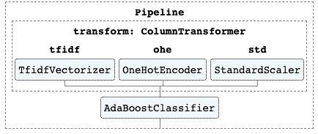
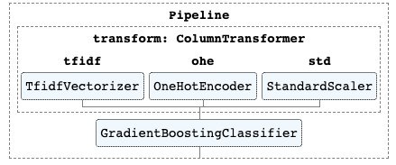
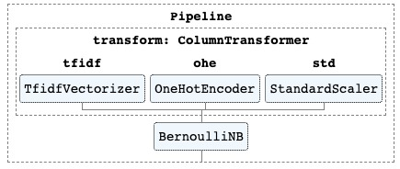
MODELLING PIPELINES & RESULTS
Accuracy : 64.0%
Accuracy : 64.4%
Accuracy : 71.1%

Slide 10
CONCLUSION
In this project we have completed five main tasks:
Exploratory data analysis
Generated additional features as a part of feature engineering
Preprocessed the input data : Scaling numerical features, OneHotEncoding categorical features and TFIDFVectorizing the comments feature
Trained Logistic Regression, Naïve Bayes, Adaboost and Gradient Boost models
Evaluated the model based on ‘accuracy_score’
The logistic regression model provided us with the best accuracy score of 72.8% but the Bernoulli Naïve Bayes model had less processing time

Slide 11
NEXT STEPS..
We plan to hyperparameter tune our Naive Bayes, Adaboost, Gradient Boost and Logistic Regression models to improve the accuracy.

Slide 12
RESOURCES
Over the course of our project, we have referred to the below research papers and resources:
Sklearn links :
Pipeline
Column Transformer
TfidfVectorizer
Logistic Regression
Naïve Bayes
AdaBoost
GradientBoost
Research papers :
Large Self-Annotated Corpus for Sarcasm by authors Mikhail Khodak, Nikunj Saunshi, Kiran Vodrahalli
A Pattern-Based Approach for Sarcasm Detection on Twitter by authors Mondher Bouazizi and Tomoaki Otsuki
Bag of Tricks for Efficient Text Classification by authors Armand Joulin, Edouard Grave, Piotr Bojanowski and Tomas Mikolov

